Slide 1
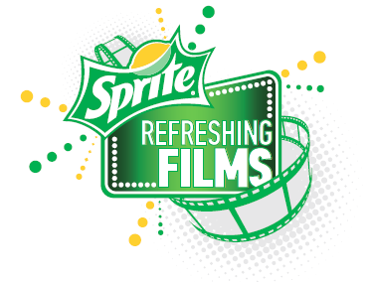
Great News! In addition to the current structure of our SRF program, the Sprite team has been given the opportunity to screen the winning film (edited to 60 seconds) in 23,000 theaters nationwide! Our winning film will serve as the pre-feature spot during the month of November (or within the next 12 months) As a result, we are making a few enhancements to the program:
Sprite branding is now required in the films (and scripts). A detailed overview on ideas to meet this requirement will be provided.
3 week extension deadline period for script entries. New deadline is February 25th.
$5,000 production budget increase per film.
(Address ownership once determined)
We hope you are as excited about these enhancements as we are! Below are some Q&A’s to help you better understand the changes:
Sprite branding will now be required in the films. What does this mean? Can I still use the same script I have been working on?
Absolutely! All this means is you now have the opportunity to enhance your film using Sprite product and branding. Your script should not be a Sprite commercial, but rather a story where Sprite is integrated in an authentic way that supports the Theme and Creative Idea.

Slide 2
I was almost finished with my script, and now I have to include Sprite branding and edit my script under 3 minutes before I can submit? ASHLEY: SHOULD THIS READ 3 WEEKS, VS MINUTES?
We completely understand that we are asking for additional thought and work to be placed into your scripts. As a result, we are extending the deadline period 3 weeks to give you enough time to adjust accordingly.
Why do I have to edit my script under 3 minutes?
Now that the films will include Sprite branding, they will be produced under the SAG commercials agreement which limits films to under 3 minutes.
How come you are increasing our production budgets by $5,000?
Producing films under the SAG commercials contract is a little bit more expensive than producing under a non commercial agreement. Therefore, we want to make sure you have enough money to produce a quality film.
Why are you making these changes now? How come we didn’t know this before?
The leadership team at The Coca-Cola Company saw the potential to make the fantastic current program even bigger and better! By incorporating branding in the films, we can now leverage multiple channels (nationwide theater distribution to 23,000 screens, PLUS social media as opposed to just on-line website exposure) to generate buzz for the film finalists and the winning film. We did not want this amazing opportunity to pass us by, so we jumped at the chance to include it in our program for this year.

Slide 3
Should you have ANY questions regarding the SRF enhancements, please contact Aviva Kleiner at 617-359-1608.
A new set of program rules reflecting these changes will be sent out to you by February 3rd.
We can’t wait to see your scripts. Good Luck!

